Slide 1
AWSML Data Visualization/Analysis

Slide 2
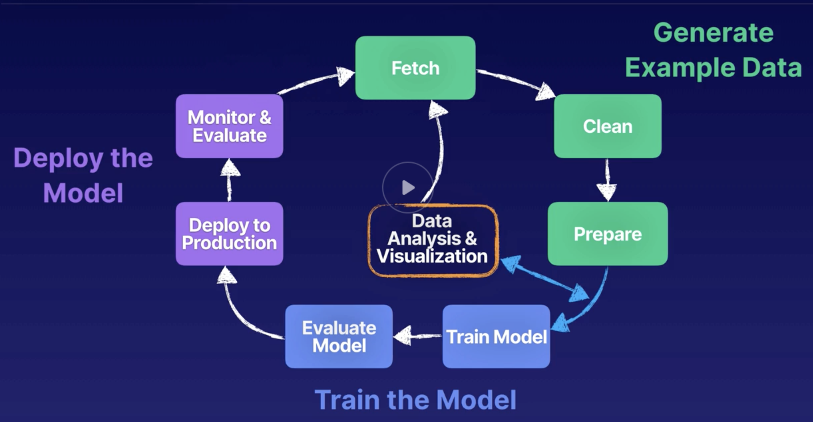
ML Cycle

Slide 3
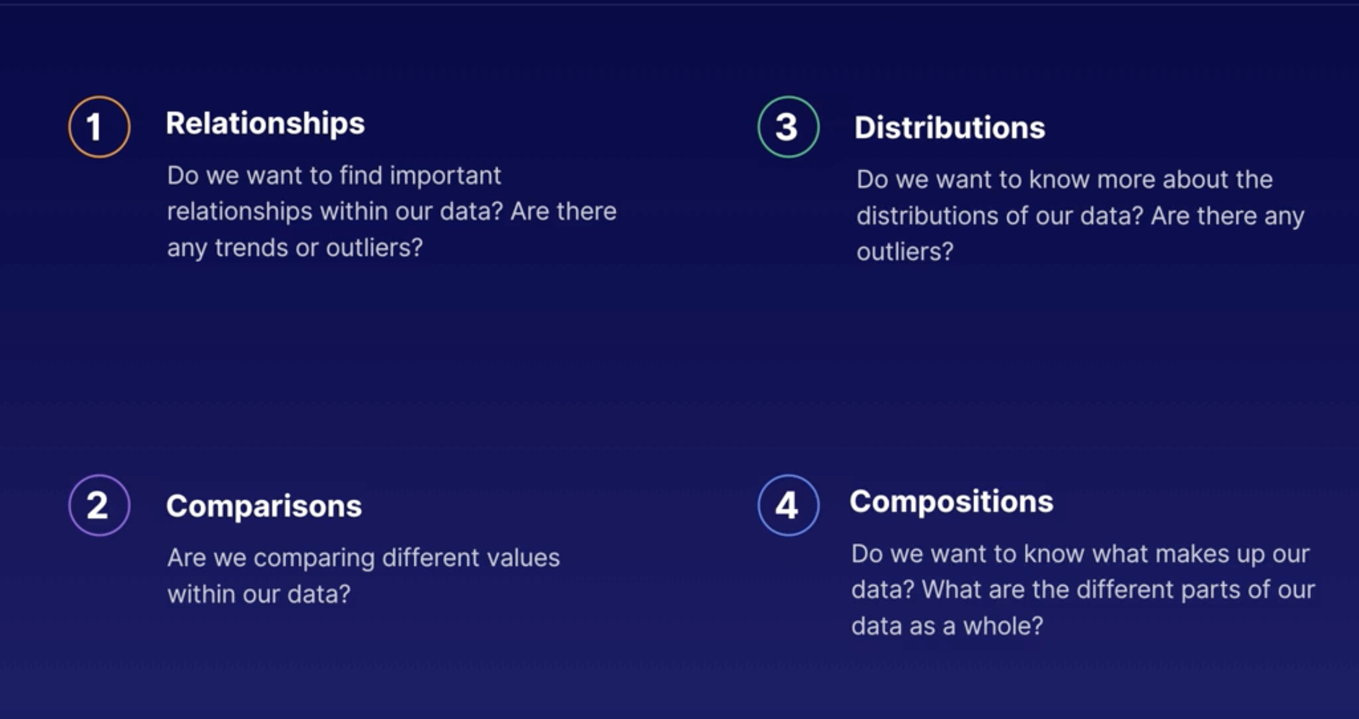
Visualization Types

Slide 4
Tools
Dev tools – R, Python, pandas, jupyter, Sagemaker
Business intelligence – Tableau, Amazon quicksight

Slide 5
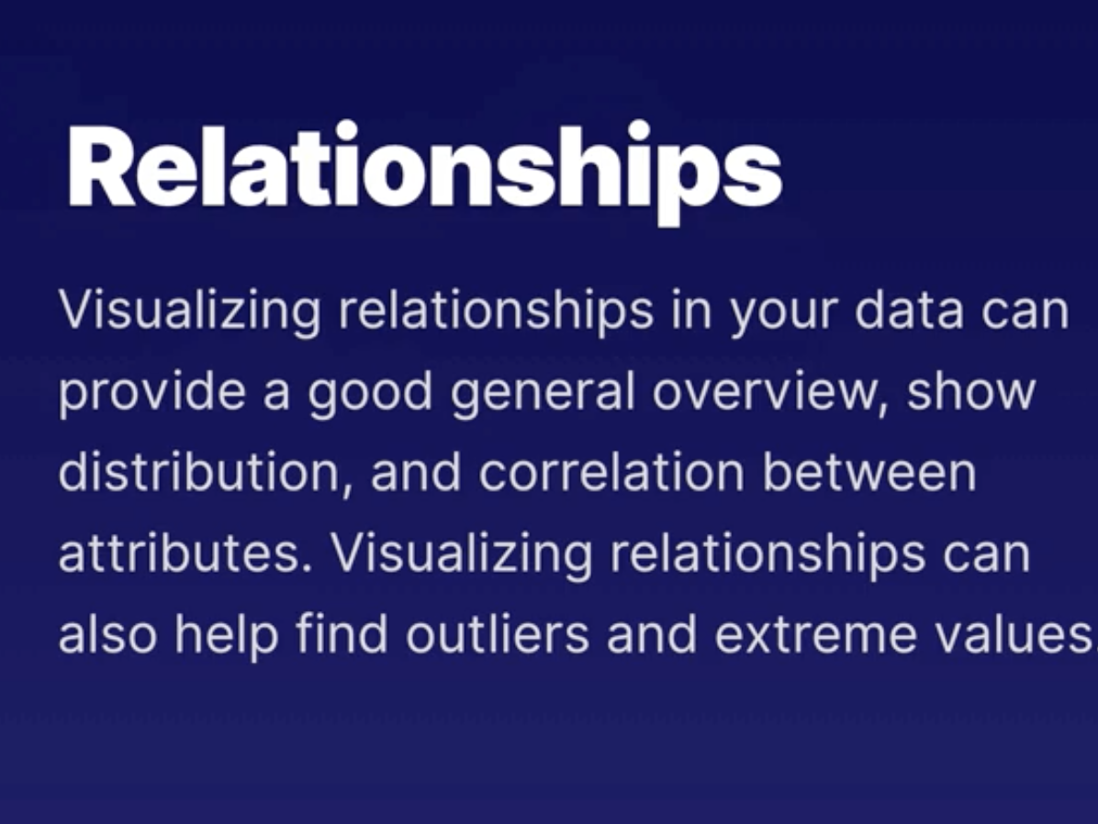
Relationship
Correlation, distribution

Slide 6
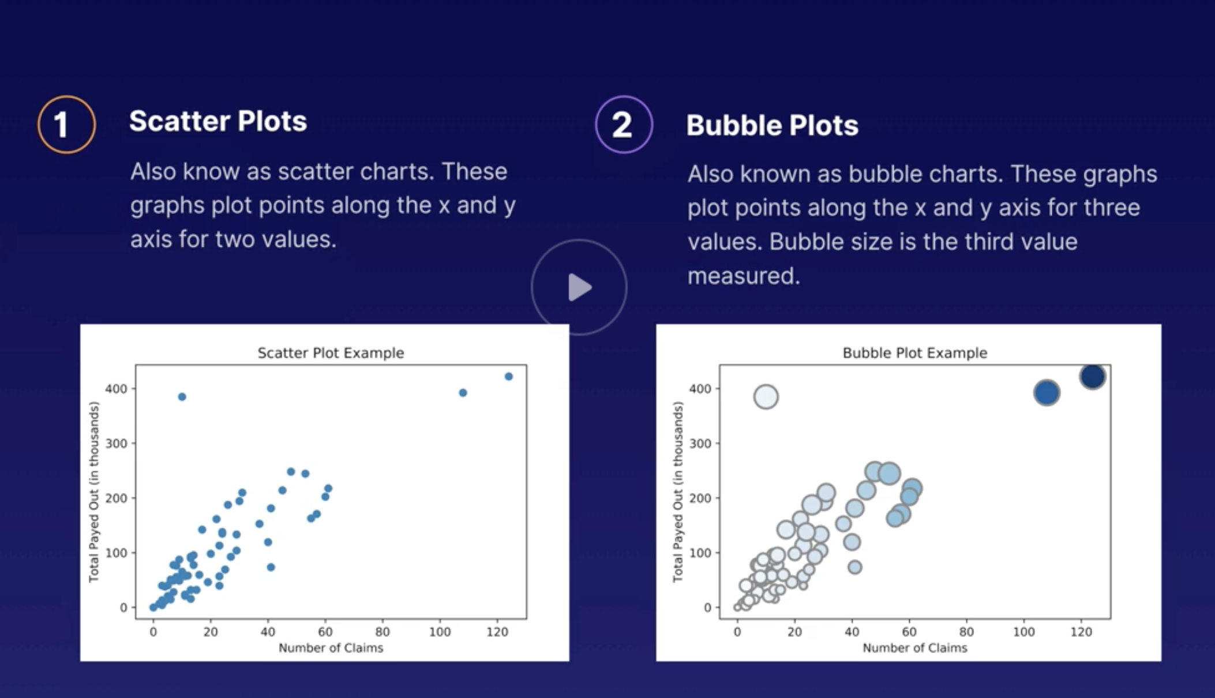
Plots
Scatter plot – has x and y value
Bubble plot – has x, y and bubble size

Slide 7
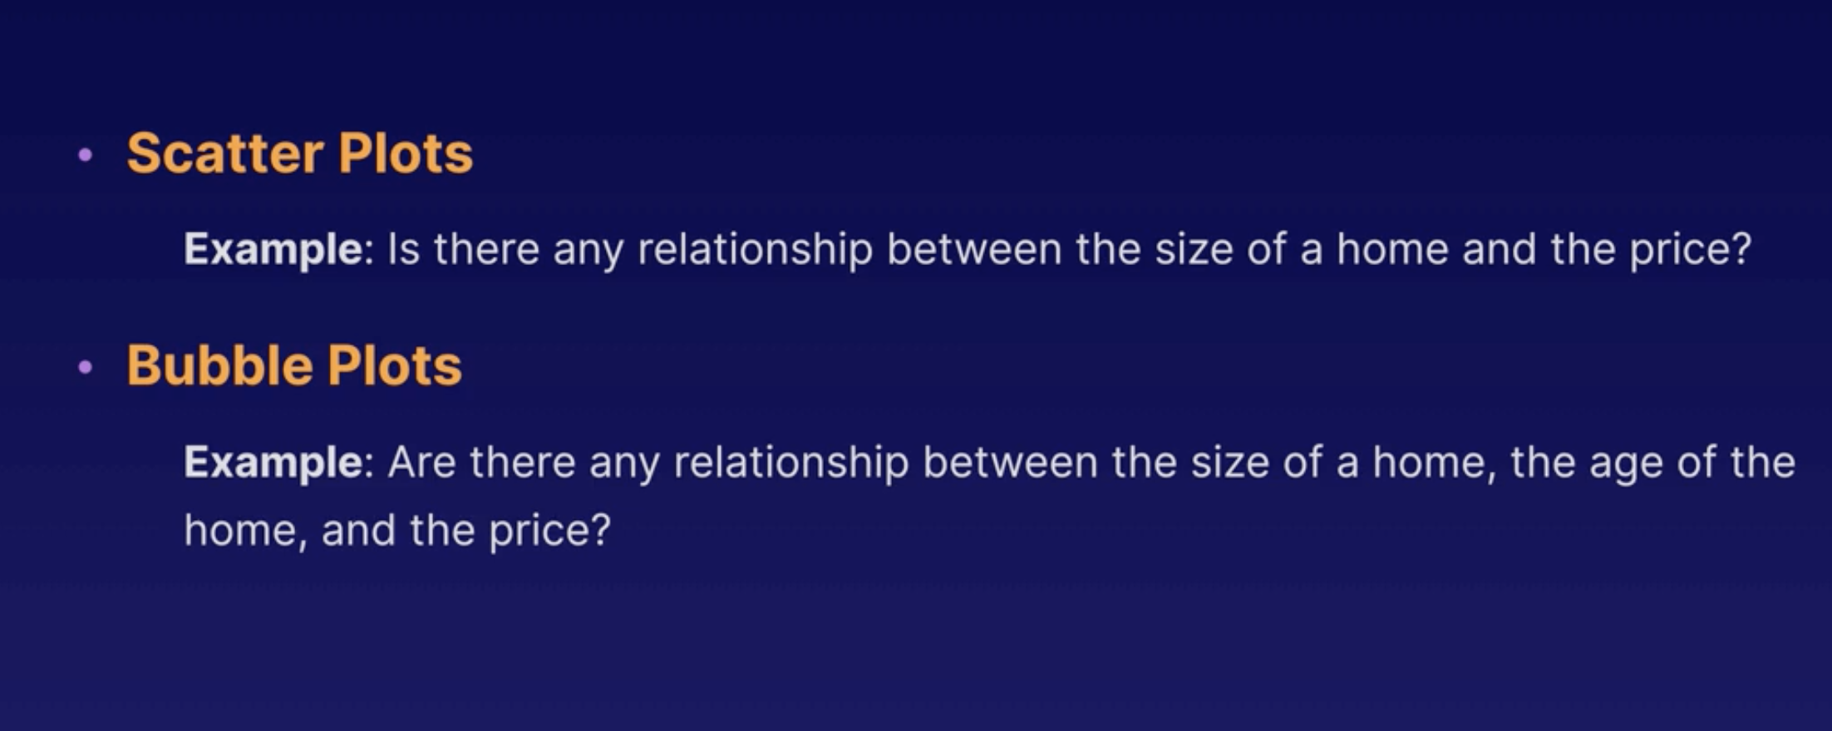
Use case

Slide 8
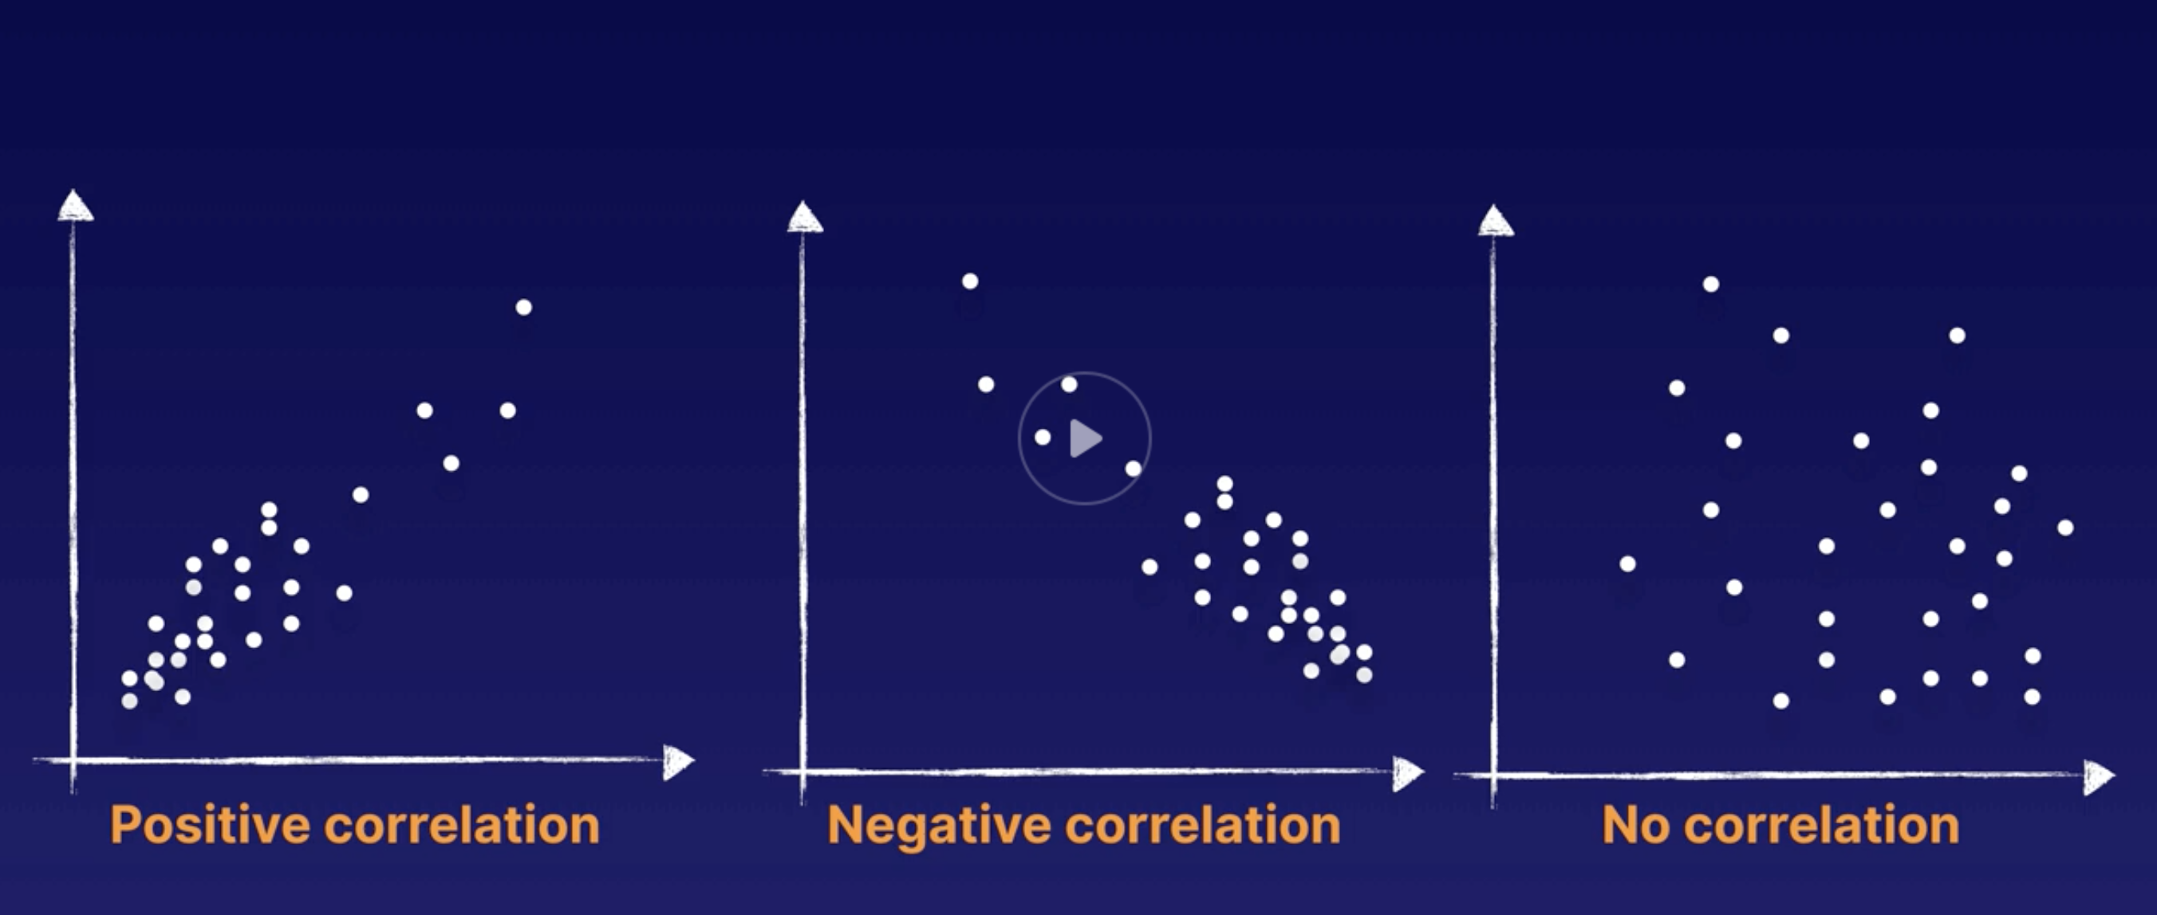
Correlation

Slide 9
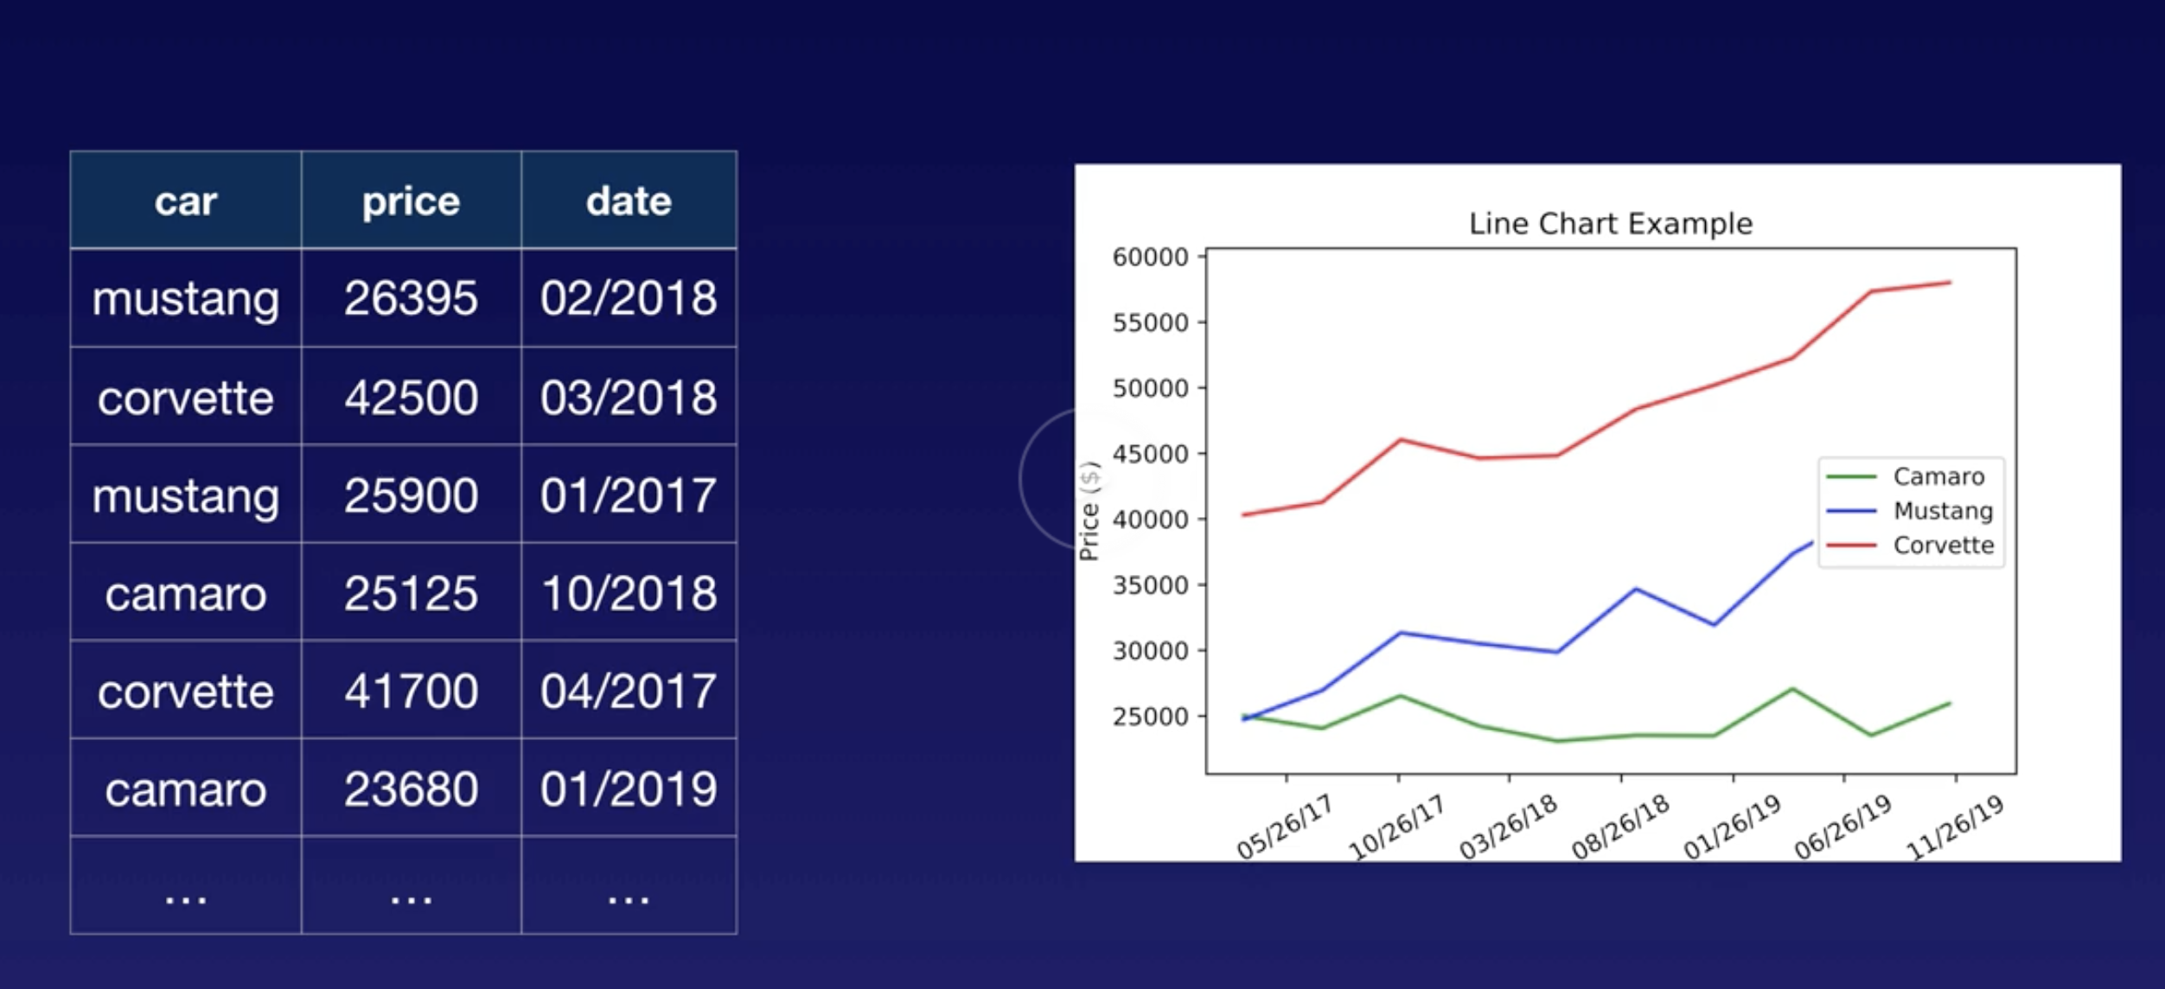
Comparisons
Showing price change over time – 3 variables

Slide 10
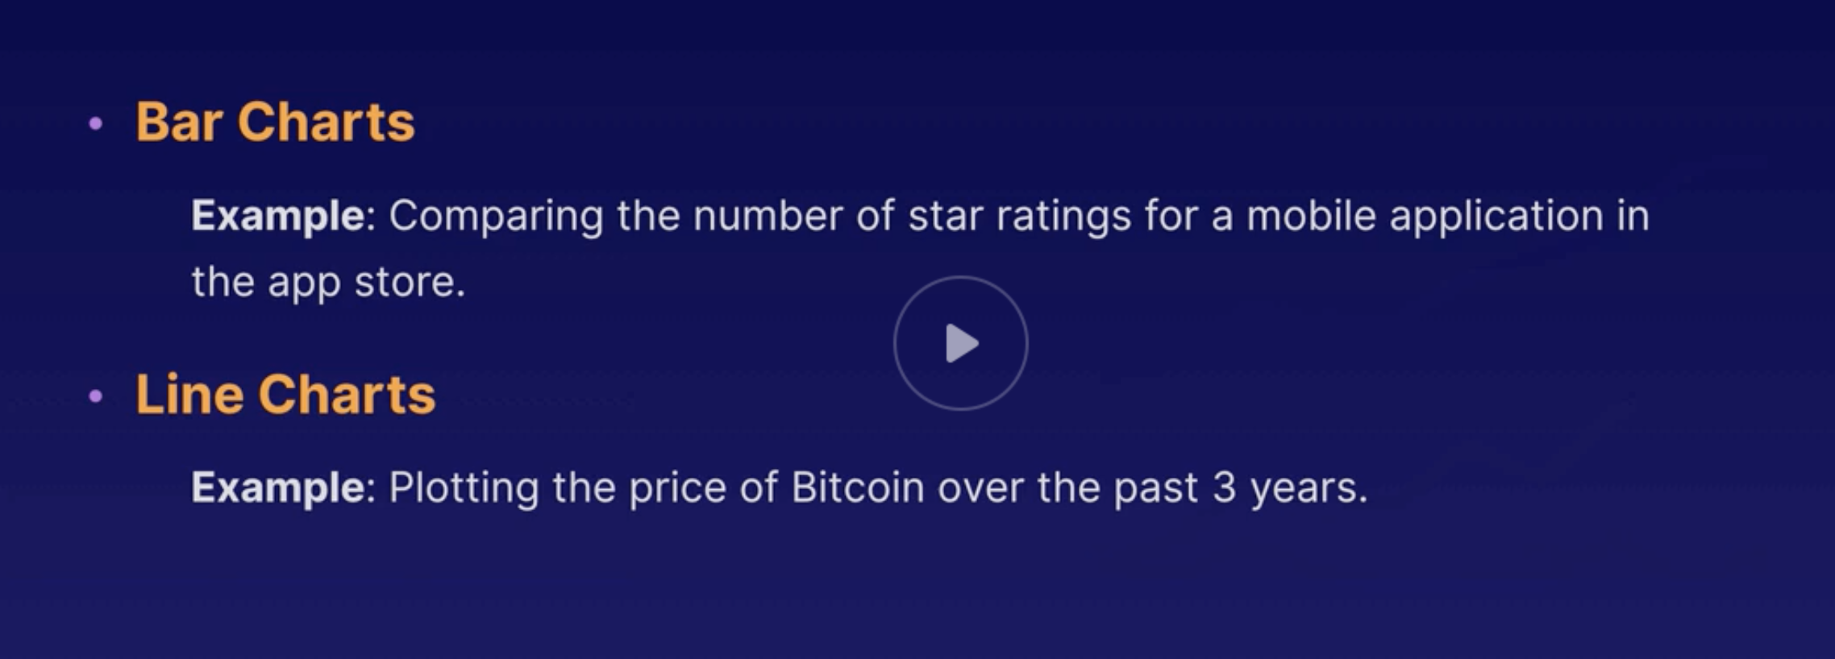
Use case

Slide 11
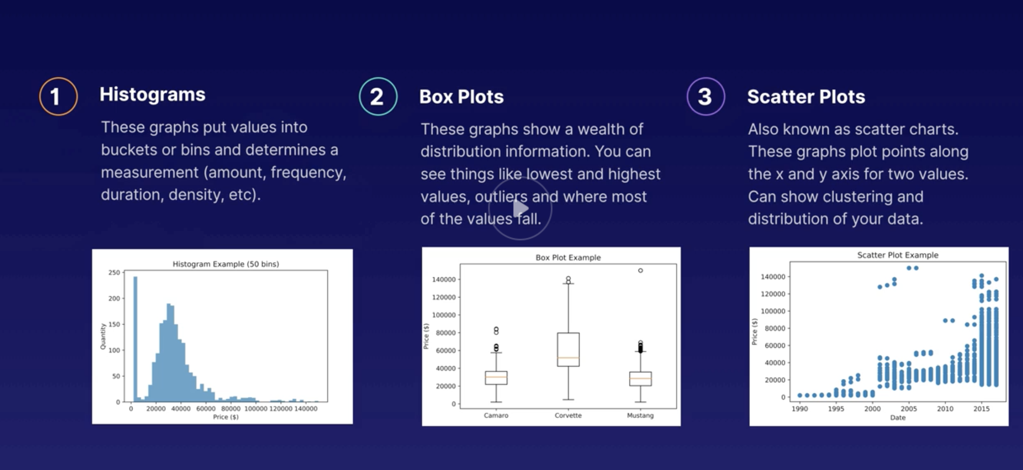
Distributions
Shows how data is grouped over intervals

Slide 12
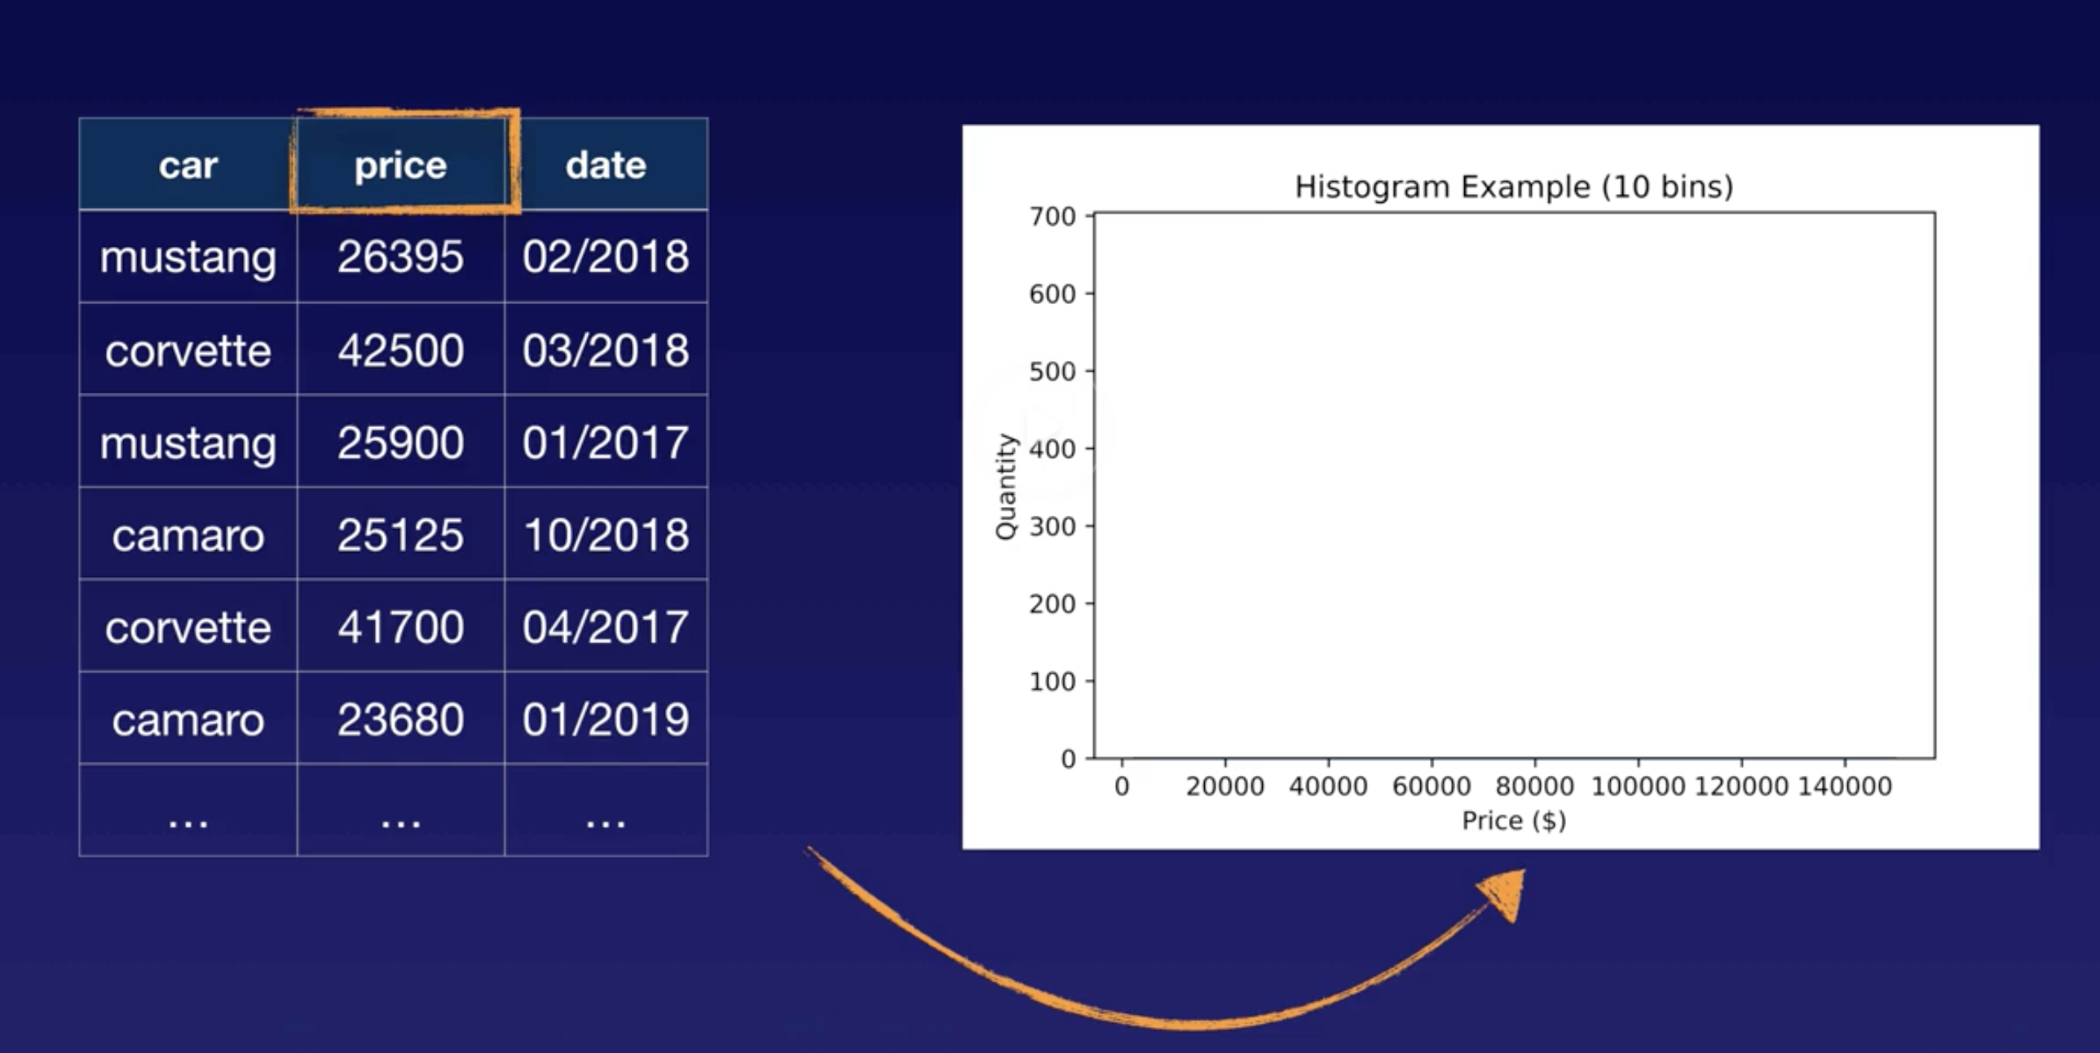
Histogram 1

Slide 13
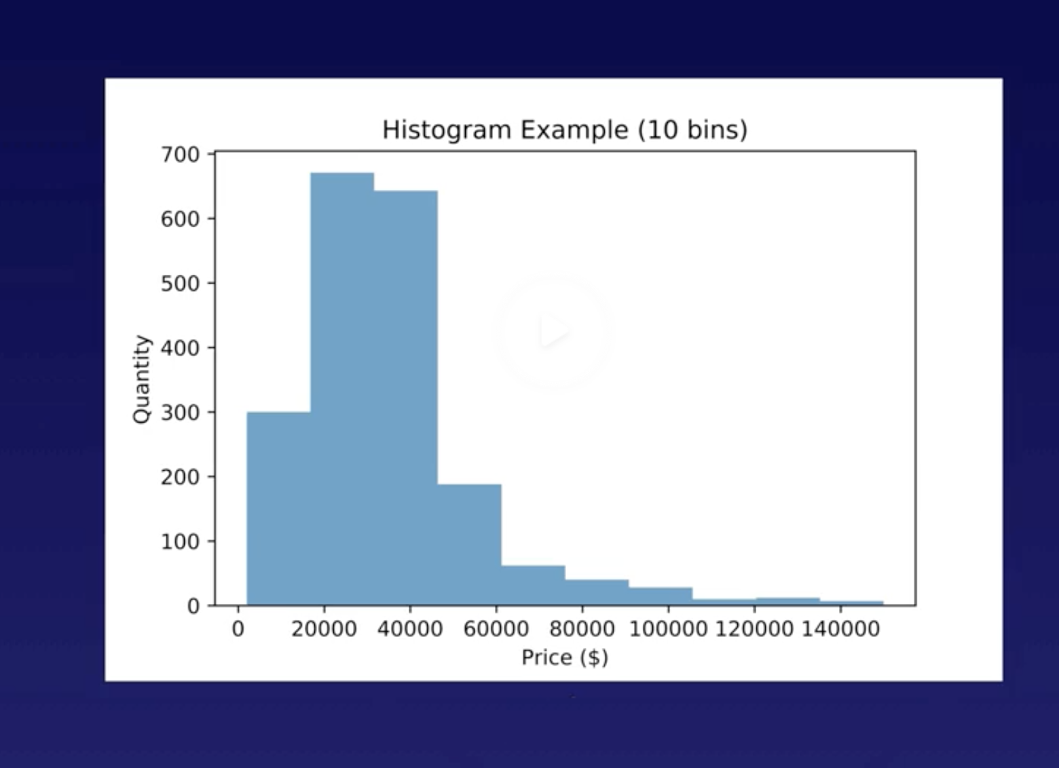
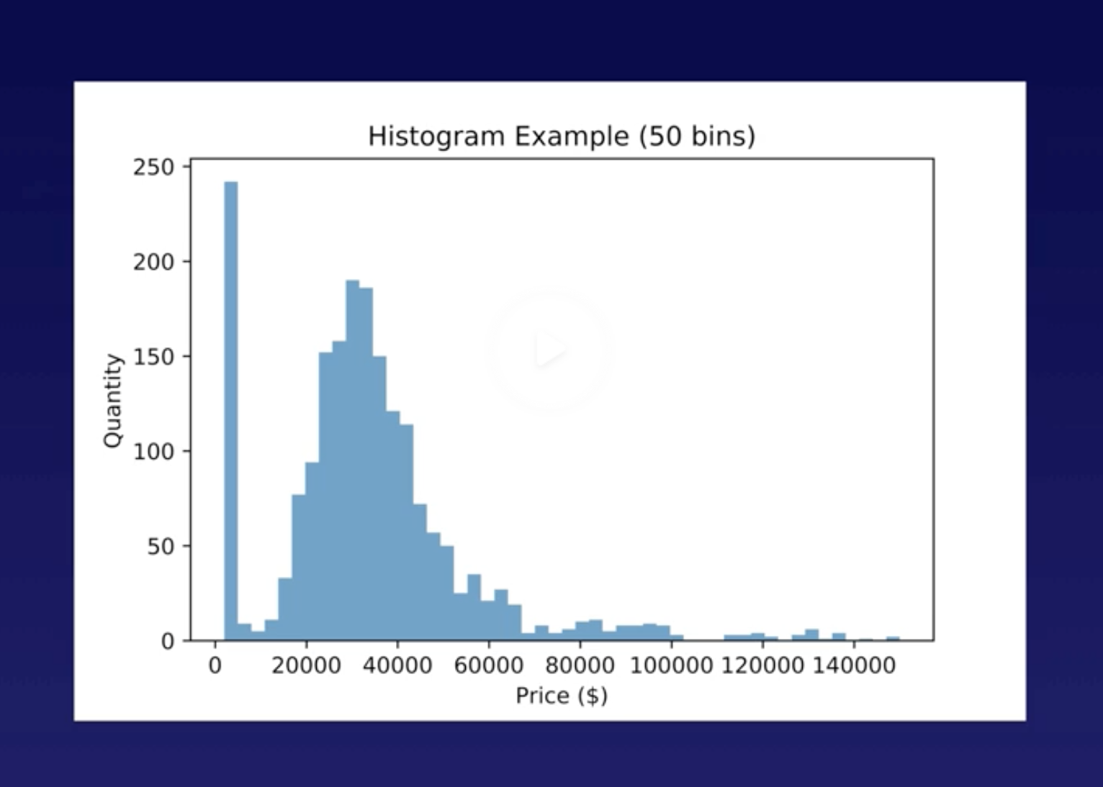
Histogram with more bins (groups/intervals)

Slide 14
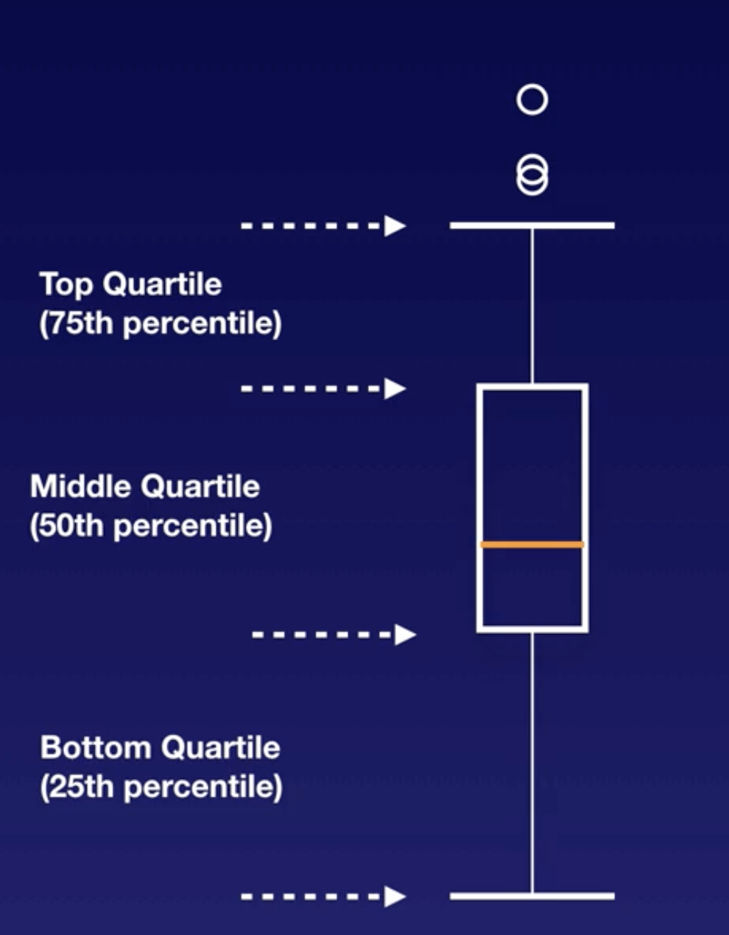
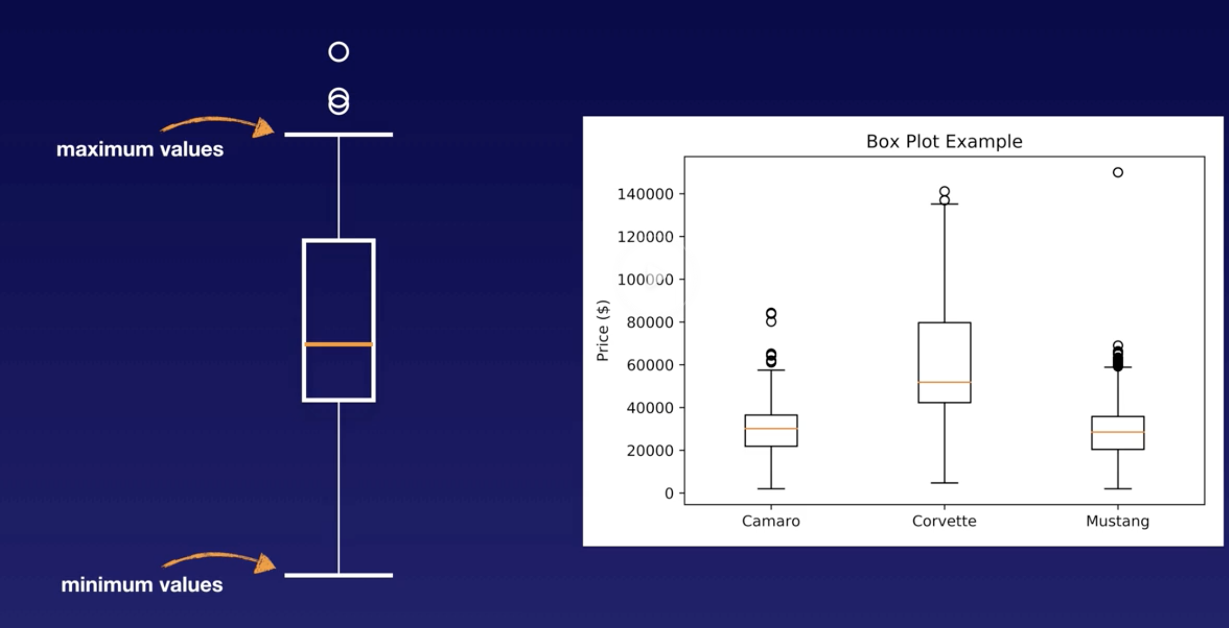
Box plots
Top and bottom lines are Minimum / Maximum values
Orange line is median value (middle value in ordered set)
Circles above or below lines are extreme values
The box shows majority of the values

Slide 15
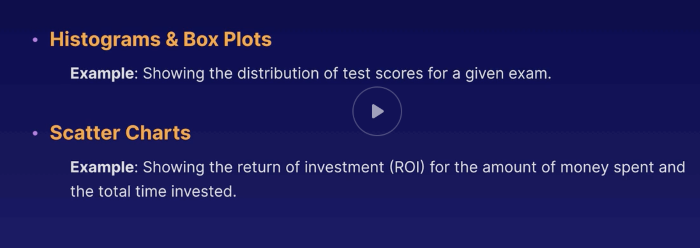

Slide 16
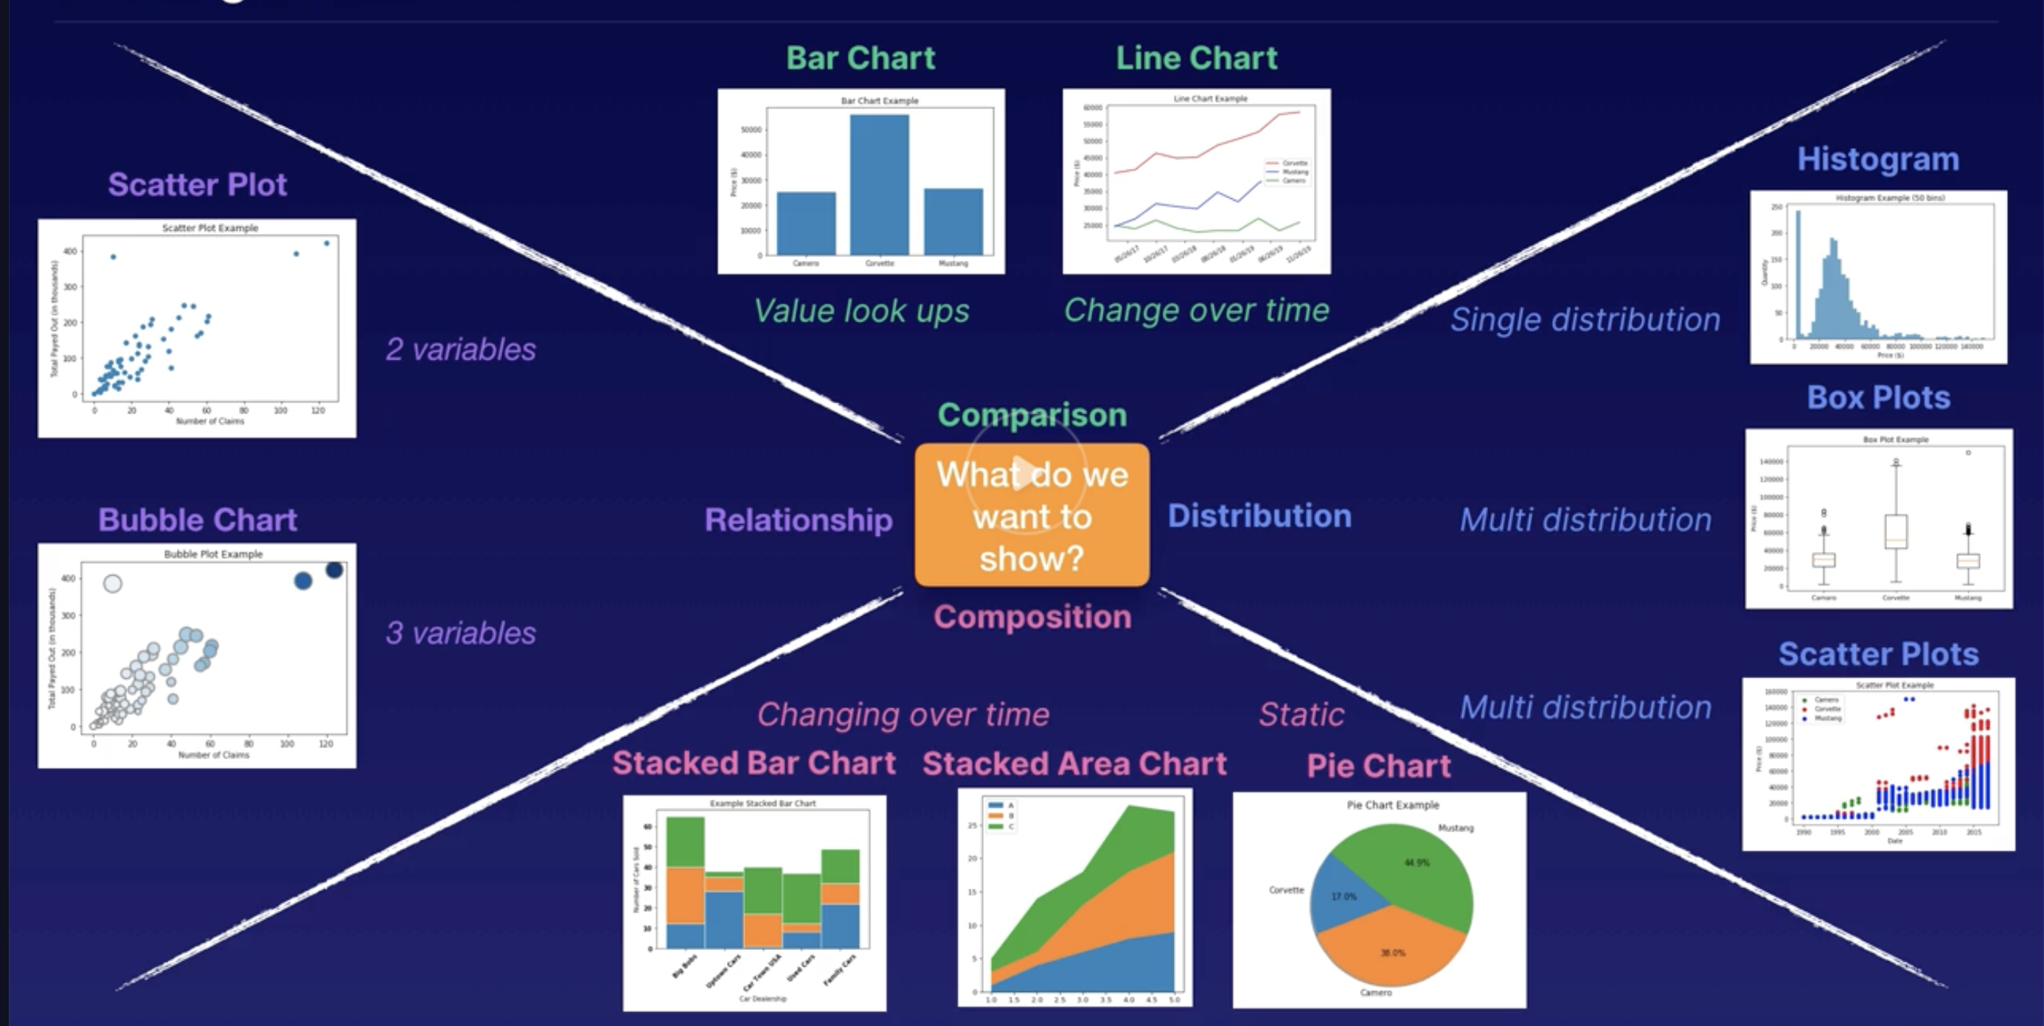
Which viz to choose?

Slide 17
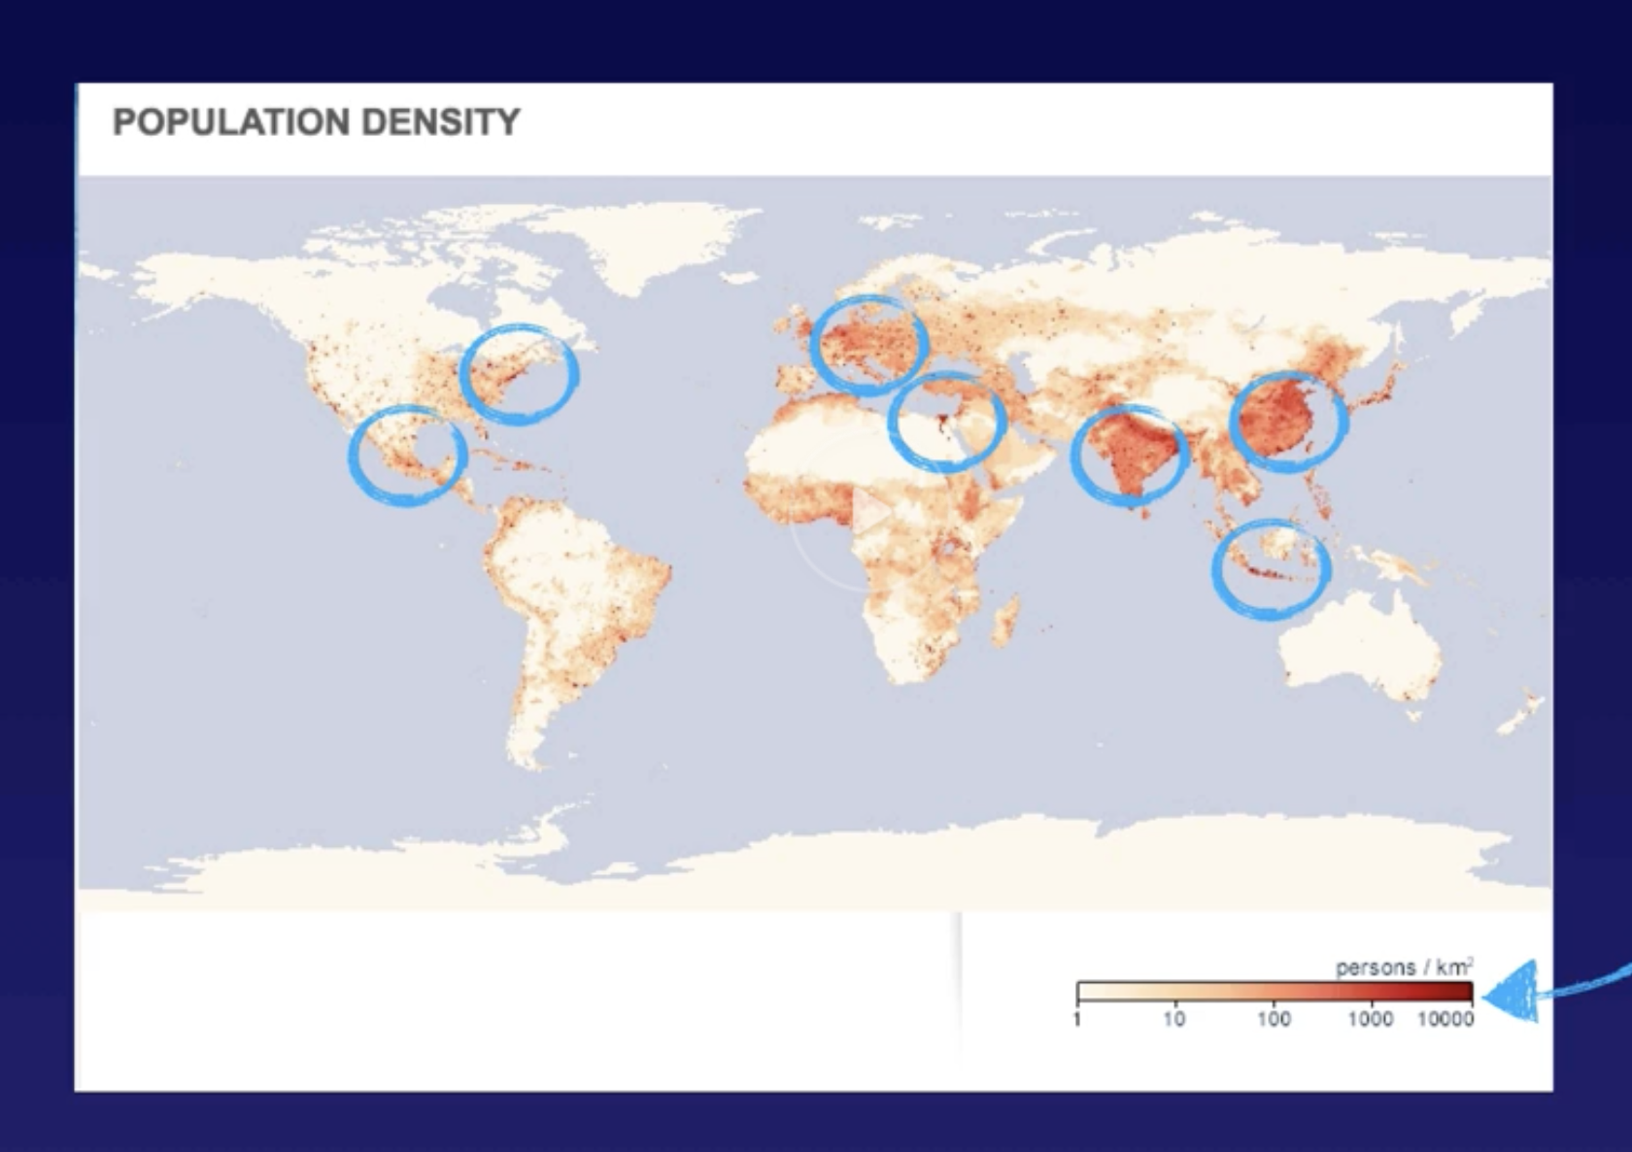
Heat Map

Slide 18
Tools
We can use jupyter or Quicksight

